Slide 1

Cybertraining Entrenamiento cibernético
Biblioteca Luis M. Santana 12/18/2018
Dr. Christina Bandaragoda; University of Washington

Slide 2
La orden del día
área de fuente de agua
Descubre los datos del clima. Encuentra otros datos del agua en data.cuahsi.org
Introducción a los modelos de datos. Publica tus datos.
Introducción a los cuadernos Jupyter. Ver los datos.

Slide 3
área de fuente de agua
Jurutungo A mapa interactivo de google
Muestra de agua
Mapa del Sistema
Clima Vecino
Jurutungo B mapa interactivo de google
Muestra de agua
Mapa del Sistema
Clima Vecino
Busca en el mapa. ¿Que mas quieres saber?

Slide 4
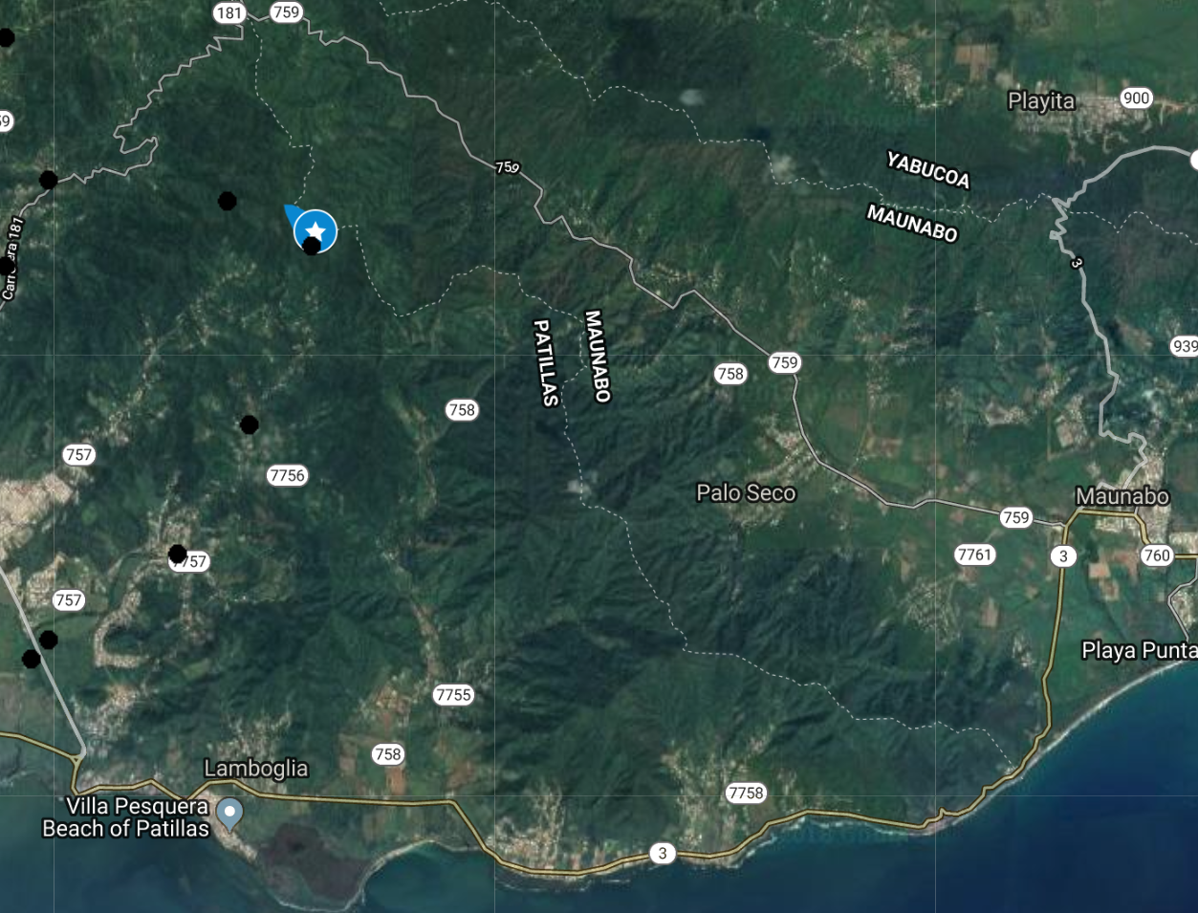

Jurutungo A Clima Vecino
Yabucoa
Maunabo

Slide 5
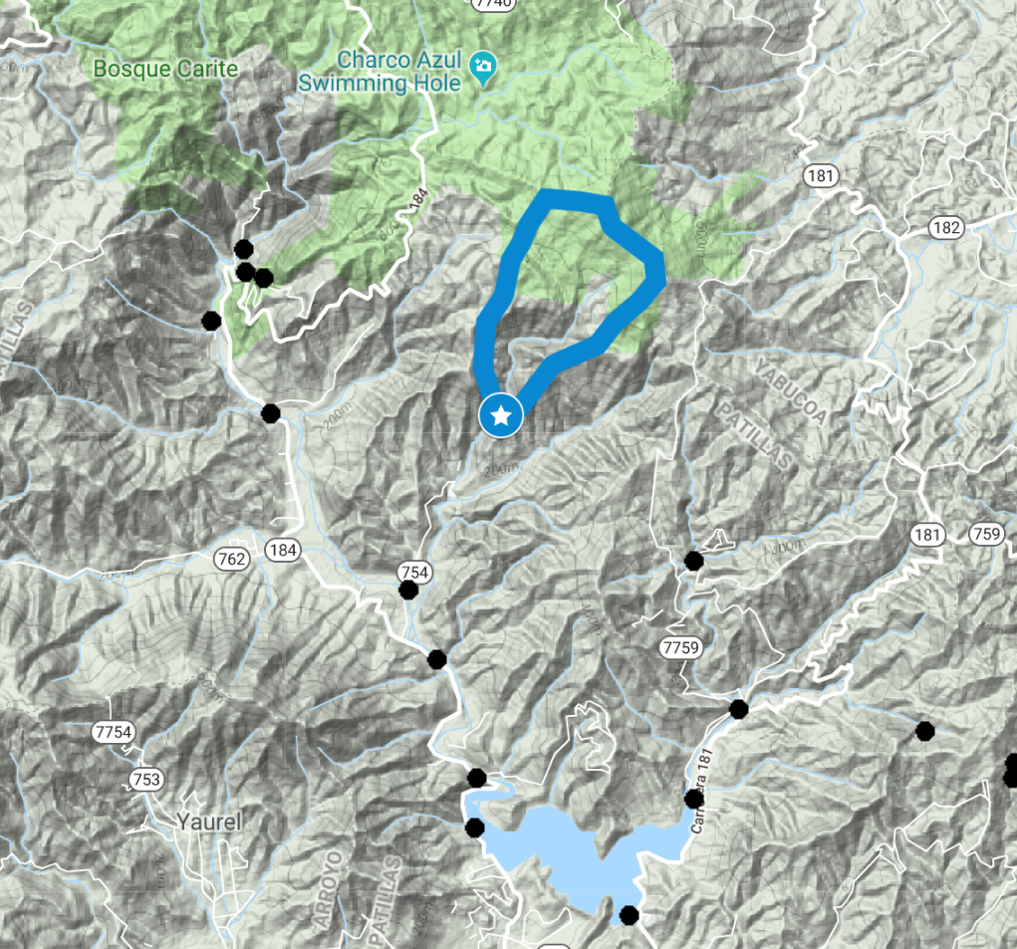
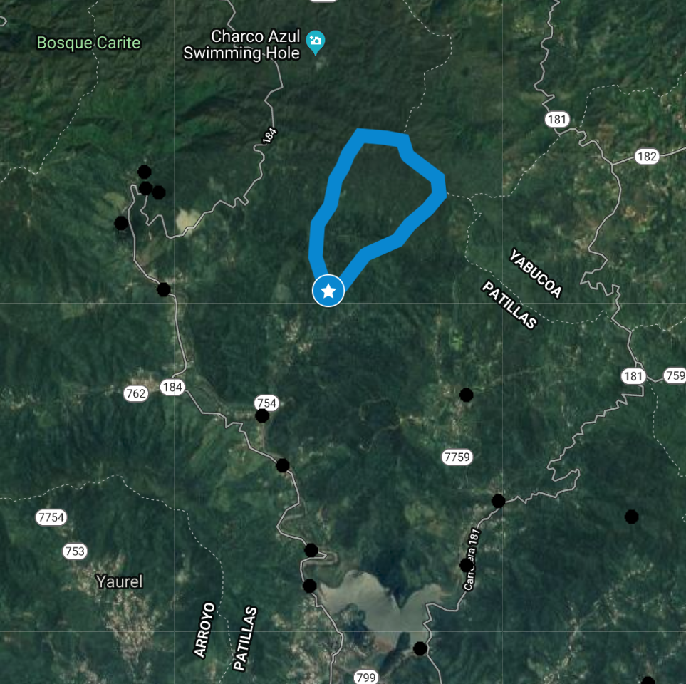
Jurutungo A Source Area
Link to Interactive Google Map – anyone with the link can view.
RAPID sampling code – A
Terrain view
Satellite View

Slide 6
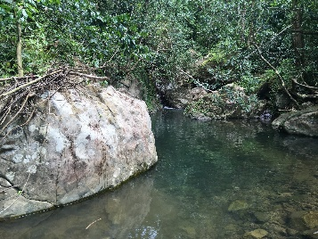
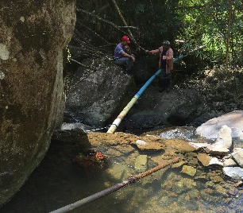
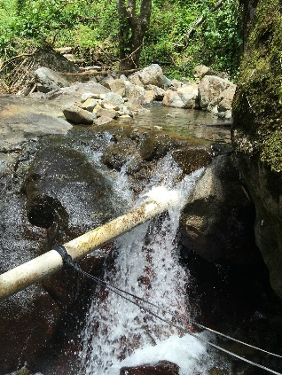
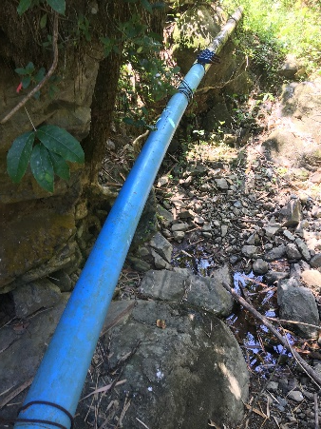
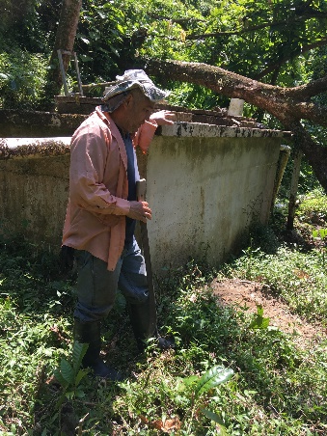
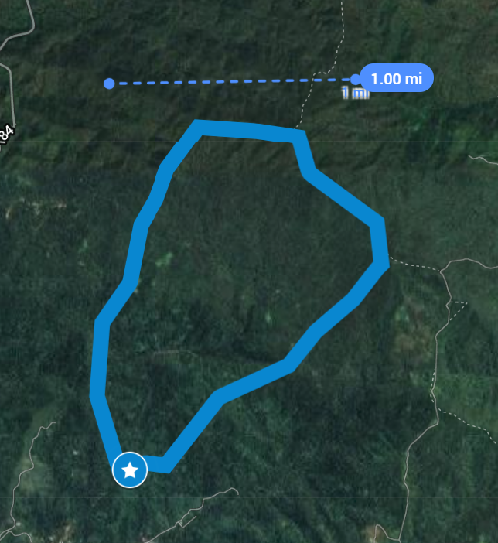
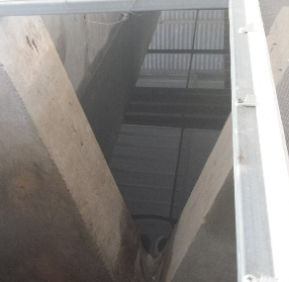
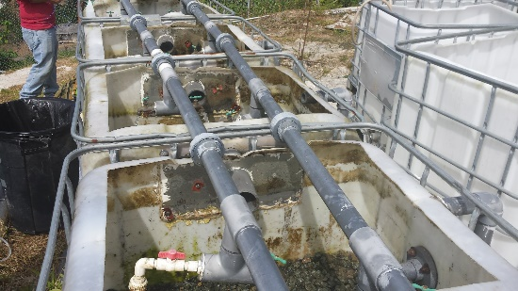
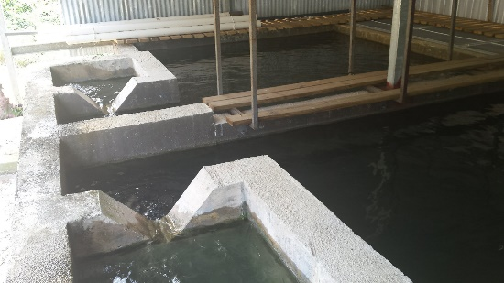
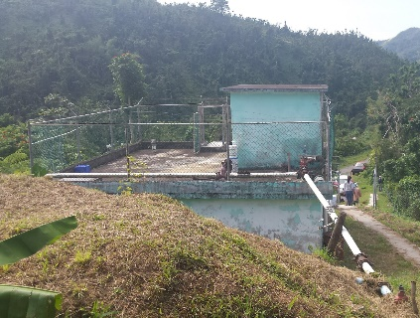
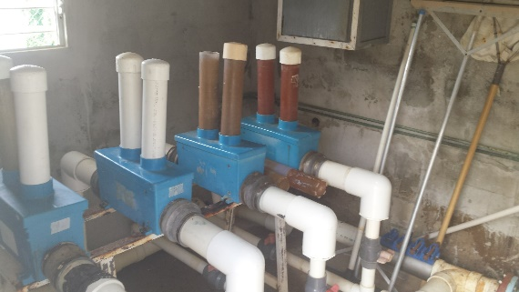
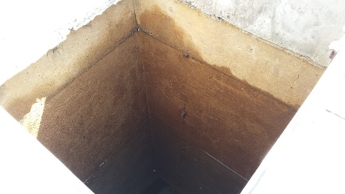
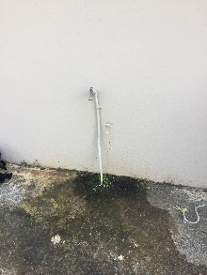
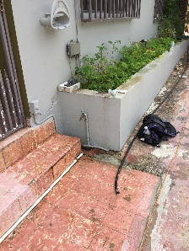
SYSTEM: A
1
2
3
Jurutungo A
Unknown source
A_SW †
Surface water¹
Dammed, uncovered reservoir w/ screen filter^{2,3}
A_Res
4
5
Large
conveyance,
3” pipe⁴
Surface
water
holding tank⁵
8
A_BT
Sediment filter⁶
Slow
Sand
filter⁷
6
7
In-line chlorination
(intermittently functioning)
Storage
Tank^{9,10,11}
~30,000 L
9
10
A_AT
Distributed water to homes¹²
A_1
A_2
12
11
A_...
A_6
Surface water source area (2 sq.mi.) draining to the A reservoir.
: Sampling Location
†: A point source for the groundwater could not be identified due to terrain
Sample names are in bold. SGW: surface impacted ground water; URes: upper-most reservoir; LRes: lower-most reservoir; HT: holding tank; ST: settling tank; BT: before treatment; AT: after treatment; n (1-6): house number sampled. System Map by Ben Davis, Virgina Tech.
Notes:
System A: MJ

Slide 7
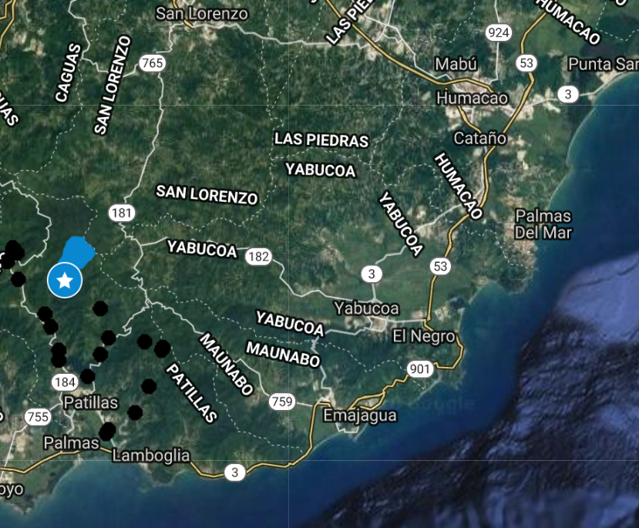
Jurutungo B Clima Vecino
San Lorenzo
Yabucoa
Maunabo

Slide 8
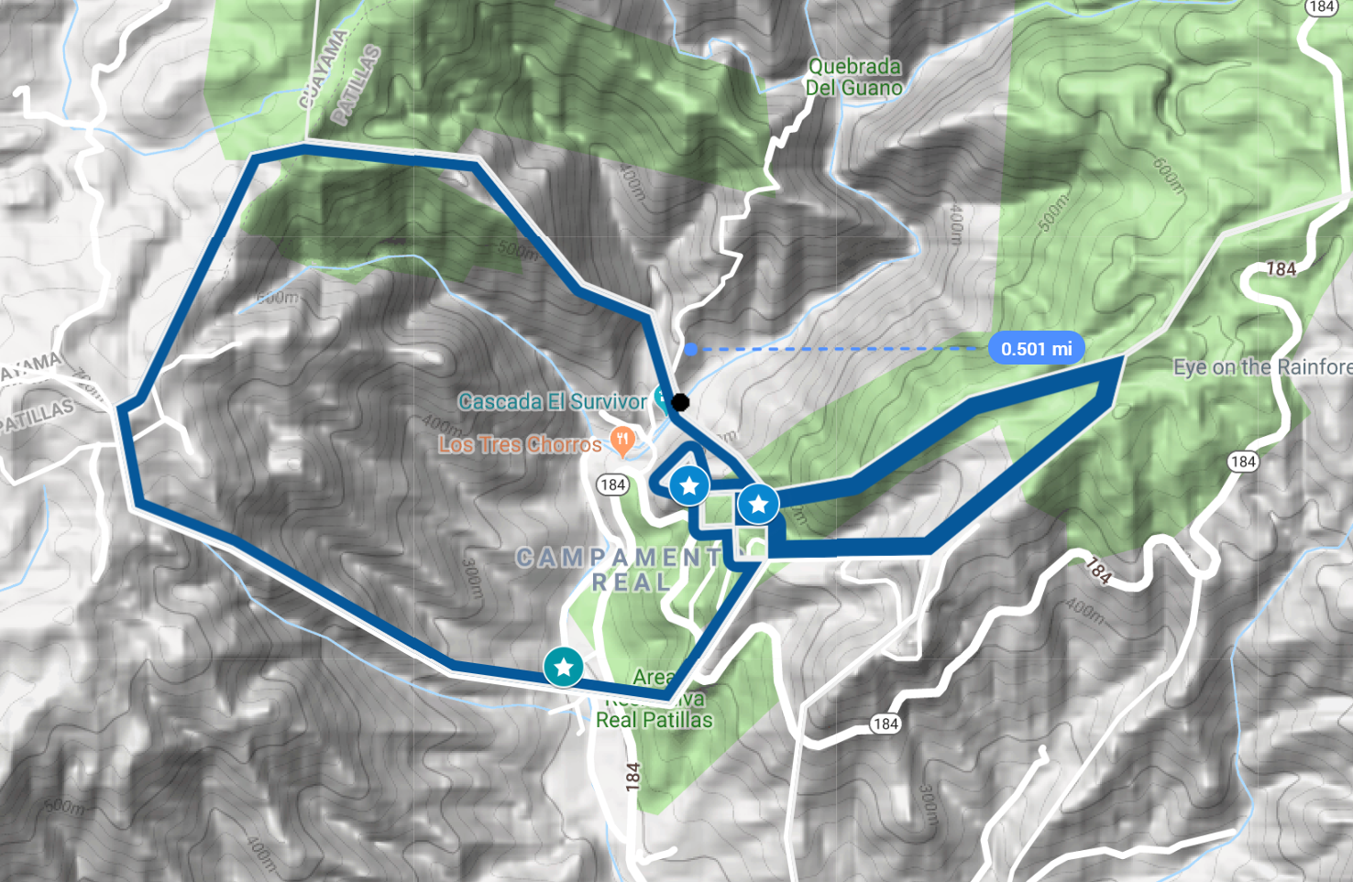
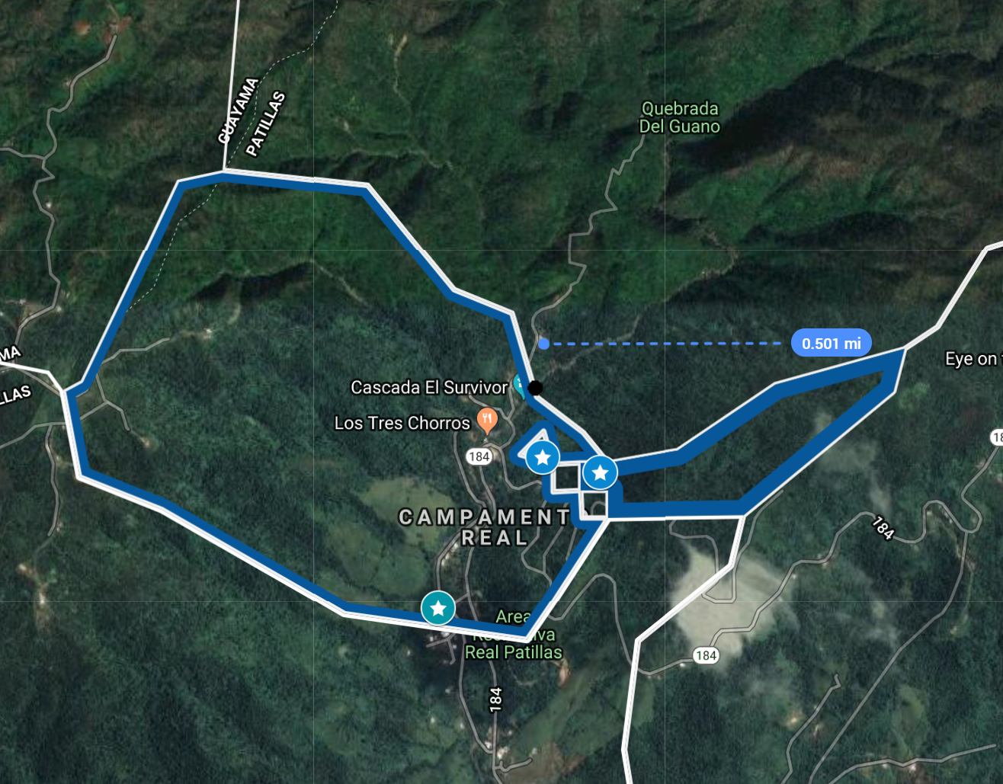
Jurutungo B Source Area
Link to Interactive Google Map – anyone with the link can view.
RAPID sampling code – B
Terrain view
Satellite View

Slide 9
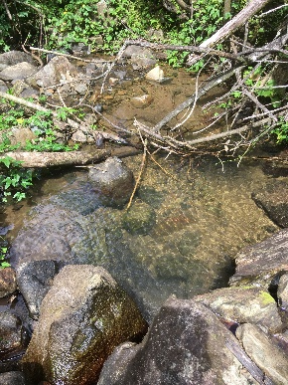
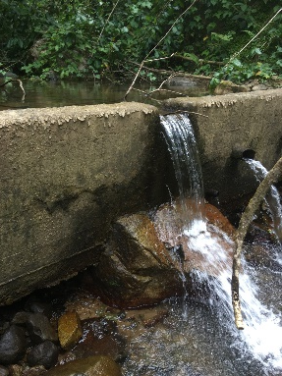
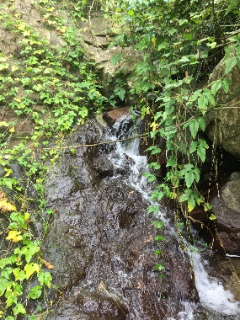
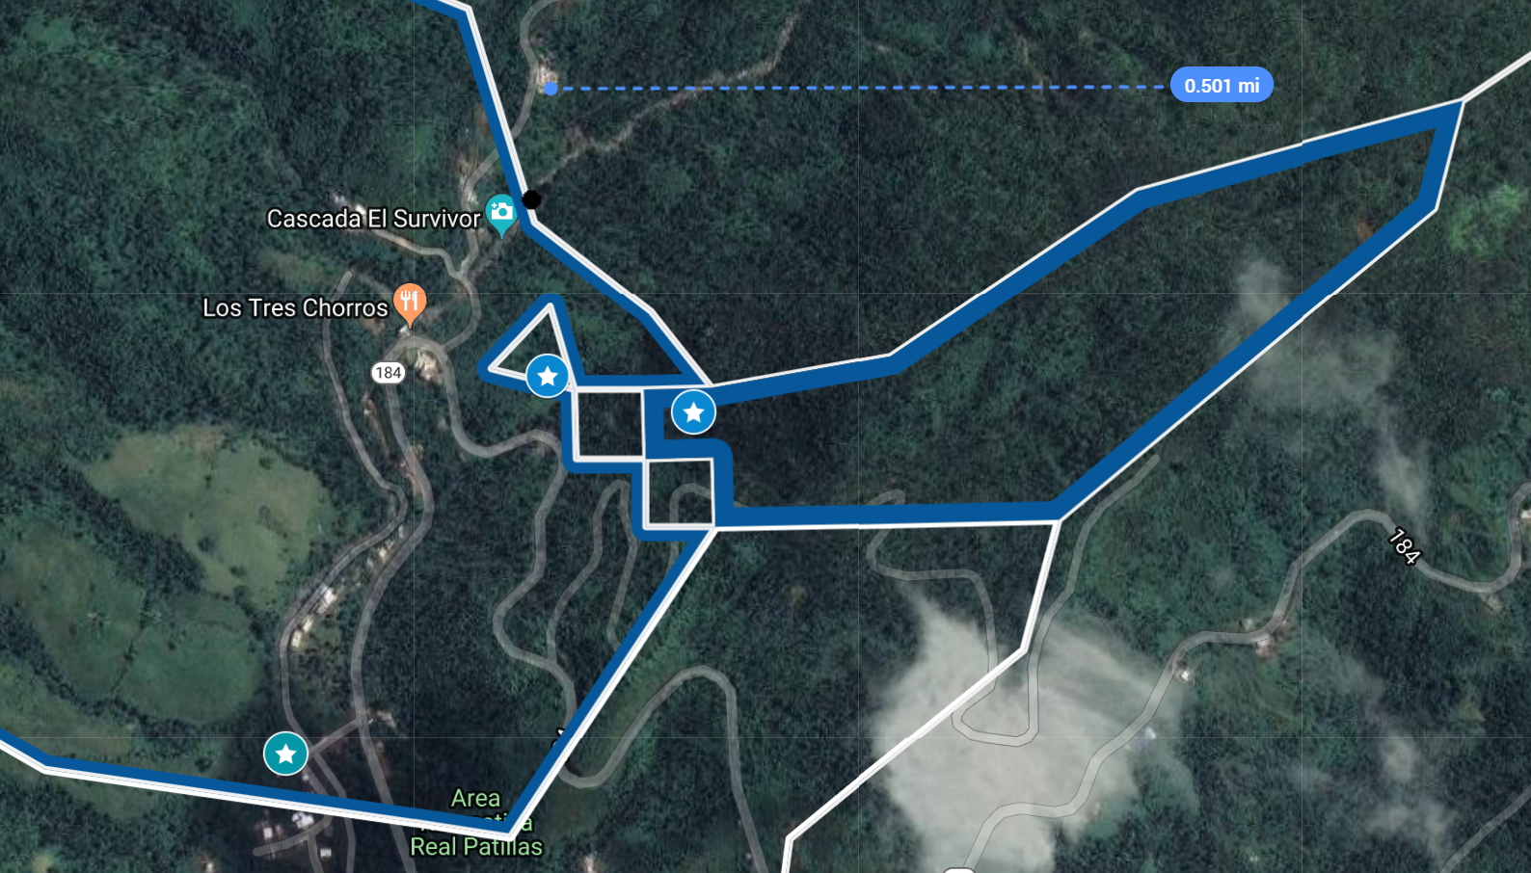
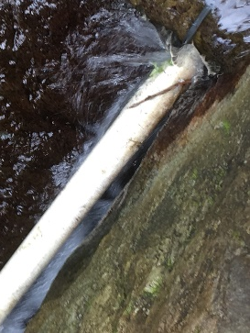
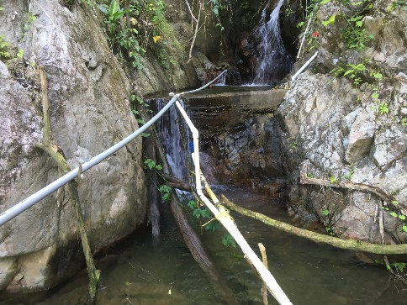
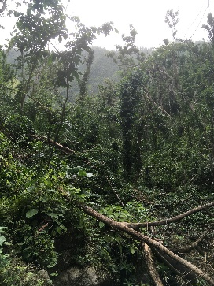
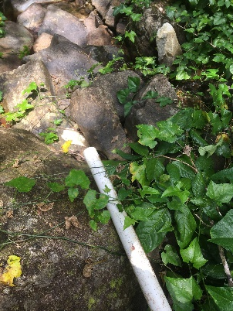
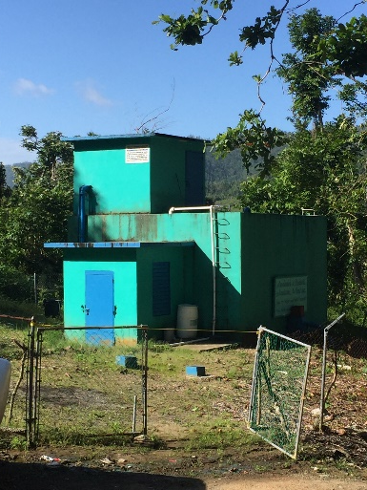
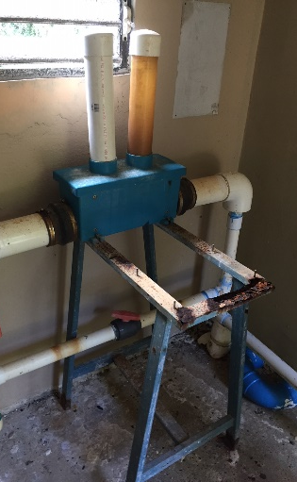
Jurutungo B
SYSTEM: B
1
2
3
Unknown source
Surface water†
B_URes
Series of five dammed, uncovered reservoirs^{1,2} w/ waterfalls or other geologic
features between
them³
New transmission lines were installed after Hurricane Maria^{4,5}, through rough, hurricane impacted terrain⁶; Old lines were abandoned in place⁷
B_LRes
4
5
6
B_BT
In-line chlorination
Storage
Tank⁸,⁹
~30,000 L
B_AT
7
8
9
Distributed water to homes
B_1
B_2
B_...
B_8
: Sampling Location
†: A point source for the groundwater could not be identified due to terrain
Surface water source area (1 sq.mi.) draining to the A reservoir.
Sample names are in bold. SGW: surface impacted ground water; URes: upper-most reservoir; LRes: lower-most reservoir; HT: holding tank; ST: settling tank; BT: before treatment; AT: after treatment; n (1-6): house number sampled. System Map by Ben Davis, Virginia Tech.
Notes:
System B: ER

